Slide 1
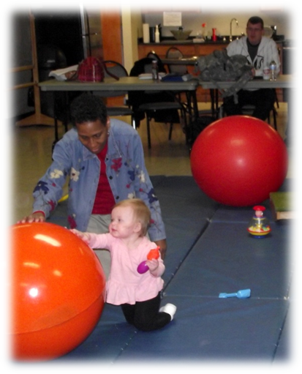
Department of Occupational Therapy
Monthly Information
Session

Slide 2
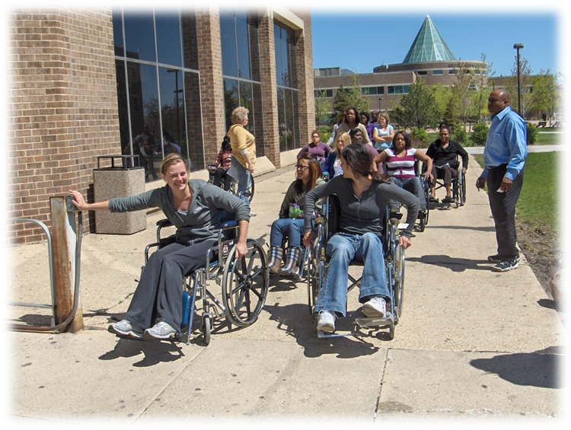
Introductions
Session Leaders
Session Participants

Slide 3
Agenda
Introduction to our program
(Approx 15-20 minutes)
Questions and Answers (approx. 10 minutes)
Individual meetings to review your unofficial Transcripts

Slide 4
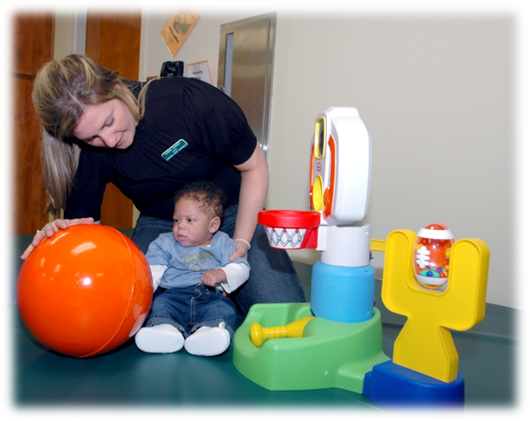
Accredited OT Programs
All OT programs have standards for content
Programs differ in focus and how they teach the material

Slide 5
What is unique about CSU’s Program?
Integrated curriculum design
learning across the life span
learning across practice settings
Emphasis on preparing students for community and emerging practice areas
Wellness to Disability continuum

Slide 6
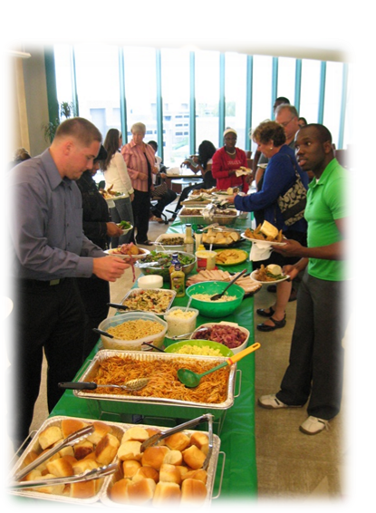
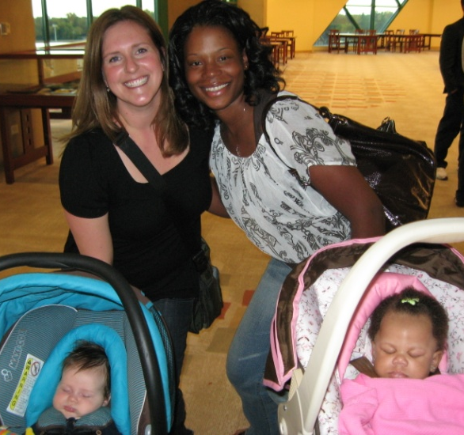
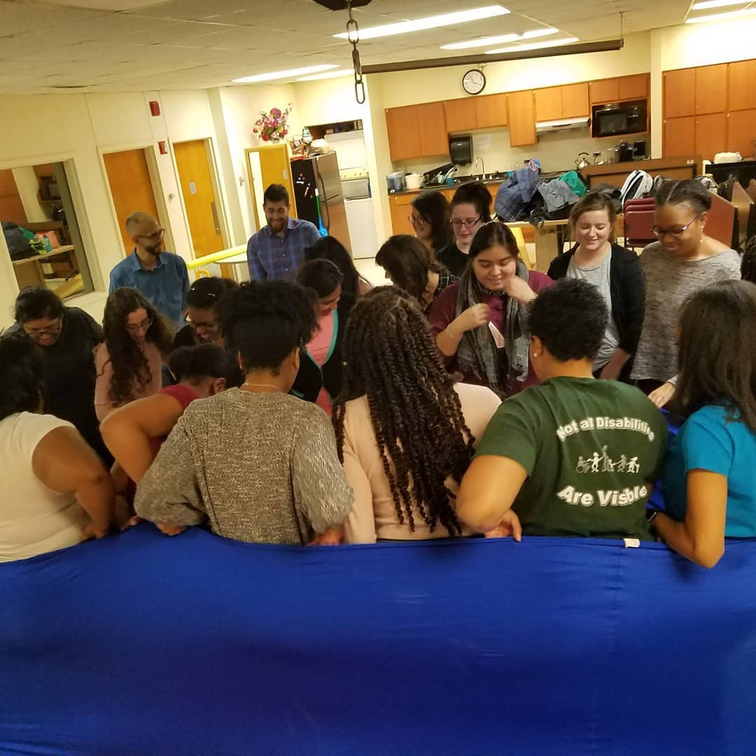
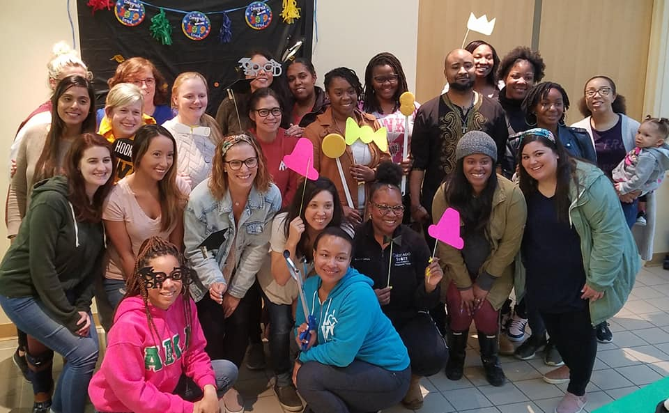
We are a community…

Slide 7
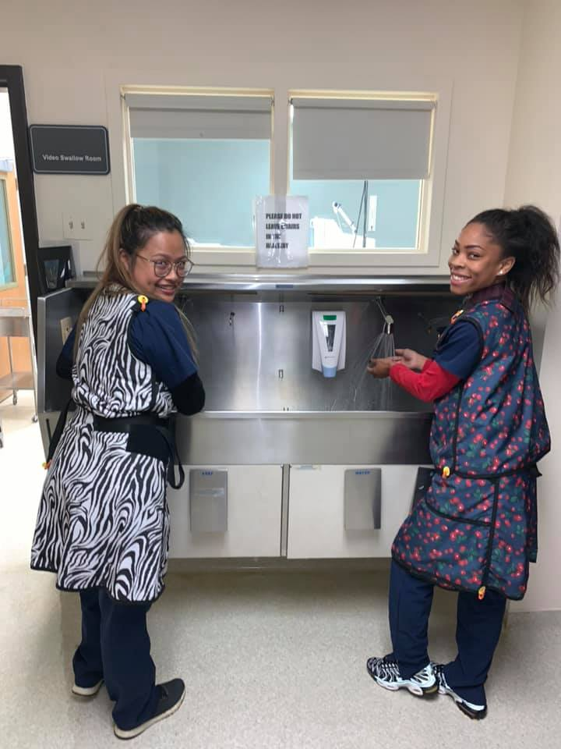
Fieldwork every semester Level I Fieldwork
1st year: 1 day/10 wks. during fall & spring semesters in small group with faculty mentor (with typical populations and those living with disability in the community)
2nd year: 1 day/10 wks. During fall & spring semesters
(in community and traditional sites)

Slide 8
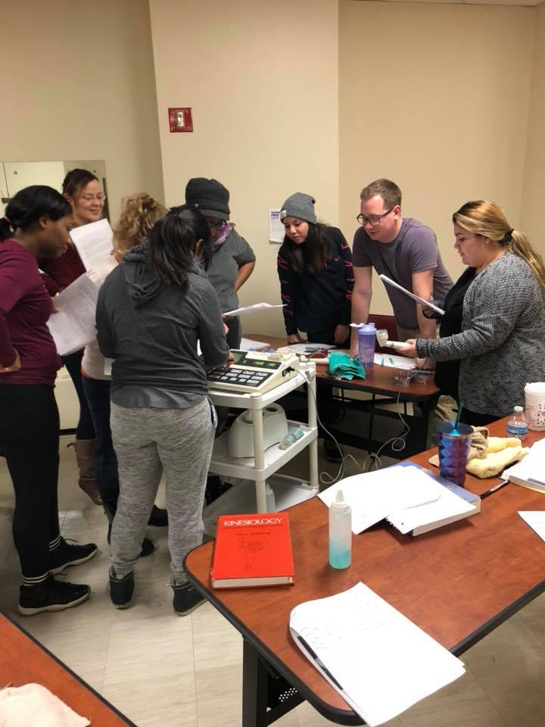
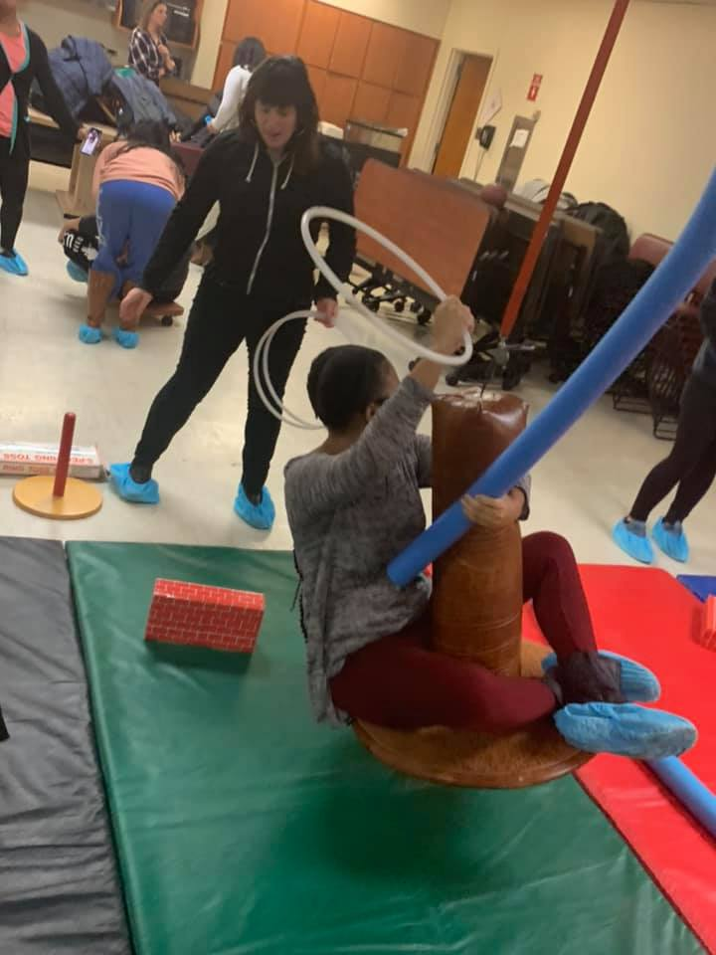
Fieldwork every semester Level II Fieldwork
3rd year: full time (40 hours/wk.), Two 12-week rotations in community and traditional settings

Slide 9
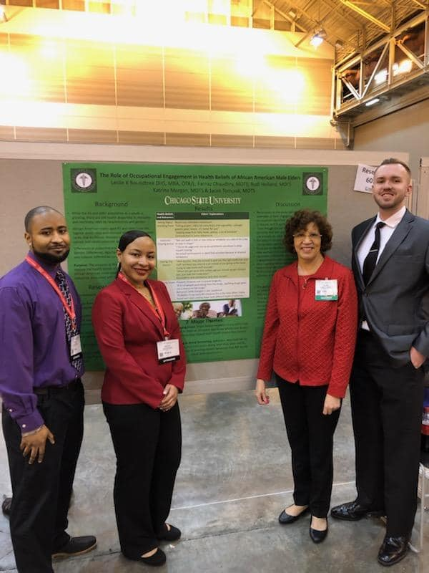
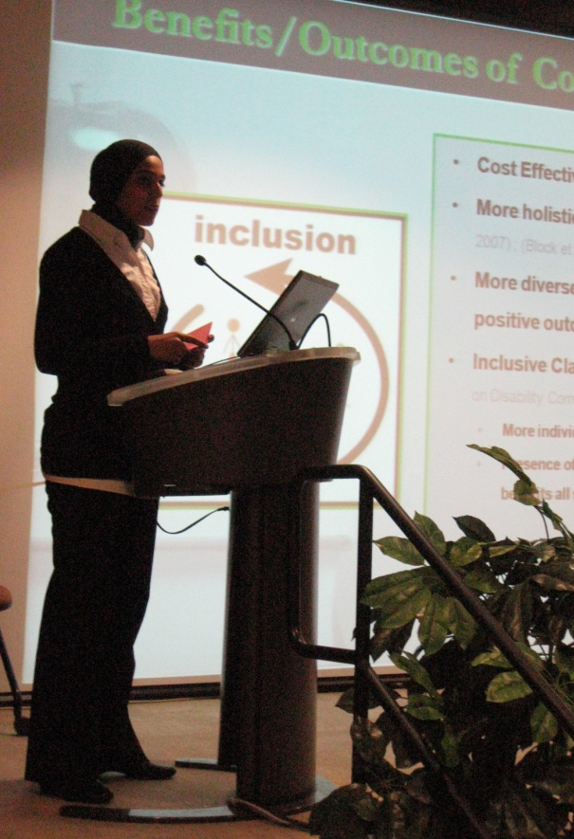
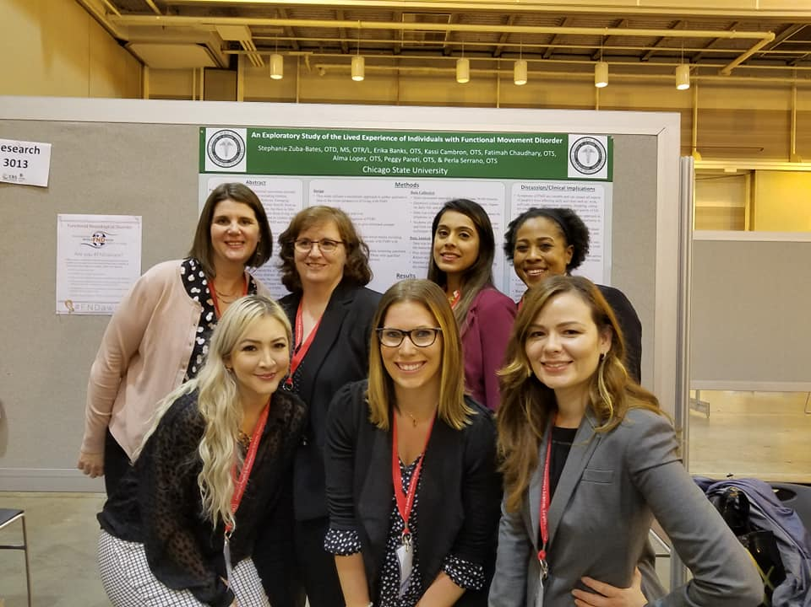
Research
Student – Faculty collaborative research projects

Slide 10
Comprehensive Testing
The program is structured to have a comprehensive testing each year with an exam for graduation
End of Year 1 Exam
End of Year 2 Exam
Exit Exam (end of year 3 Exam)
Requires students to review content and build upon content
Practice for the NBCOT exam

Slide 11
National Board for Certification in Occupational Therapy (NBCOT)Exam Results
2019 CSU MOT passage rate: 94%
The national average: 98%
2020- so far so good!!!

Slide 12
Applying to the OT Masters Program
If you have (or will have) an undergraduate degree
Need to apply online for the MOT program, https://www.csu.edu/graduateschool/admissions/gradadmission.htm

Slide 13
Entering the Combined program BS in Health Sci/MOT
If you are already a Pre-OT major at CSU:
Apply directly to the OT Department for admission to the professional OT Program,
https://www.csu.edu/collegeofhealthsciences/OT/admissions.htm

Slide 14
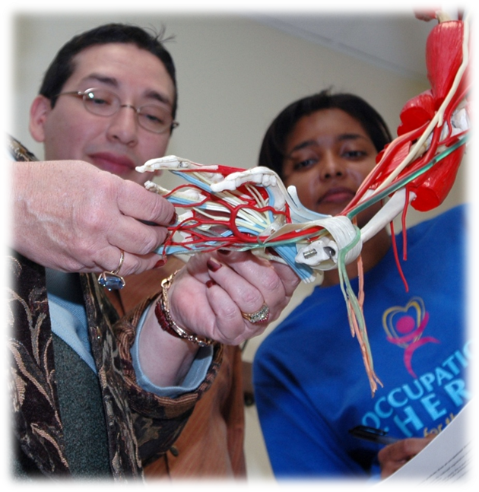
Prerequisites for the MOT Program
Anatomy and Physiology
Cadaver lab
Abnormal Psychology
Lifespan Psychology
Statistics
Intro to OT
Intro to Anthropology or
Sociology
Medical Terminology

Slide 15
Science Prerequisites For either Program
Anatomy and Physiology (8CH min.)
Completion of separate anatomy (4CH) & general physiology (4CH) courses
Or completion of both AP I and AP II
Human Cadaver lab
30 hours (dissection or prosection)
Science prerequisites need to be taken within 5 years to be current (currency)
Must have received a passing grade on any “expired” science course in order to take again for currency

Slide 16
Prerequisites for either program
Repeating courses
Cannot take or repeat any OT prerequisite course (including sciences) more than twice for a passing grade

Slide 17
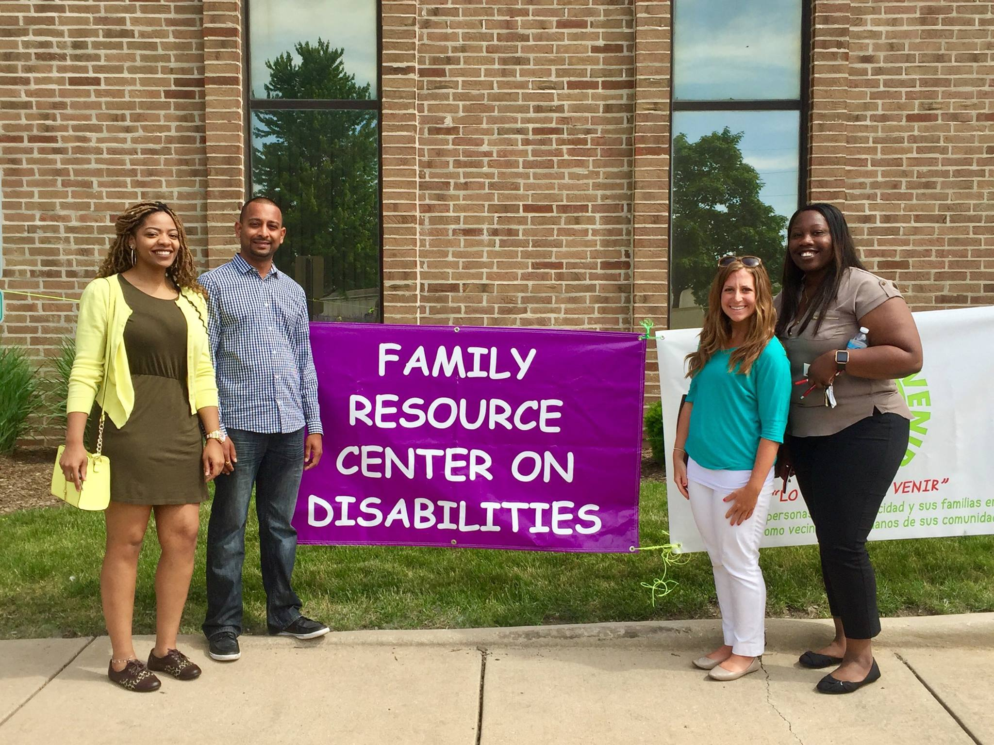
Other Application Requirements
2 Recommendation Letters
One needs to be from an upper level course instructor
Need to use Recommendation Forms provided
Human Service
40 hours of human service delivery
Essay
Note: For MOT applicants, all these items are uploaded in
the online application

Slide 18
Scholarship Opportunity
Diversifying the OT Workforce (DOTW) Scholarships for Disadvantaged Students Grant
$3 million grant over 5 years awarded to the OT Department at CSU
Federal grant- funded by the Health Resources and Services Administration (HRSA) under the U.S. Department of Human Services
Purpose is to assist educationally and economically disadvantaged students to complete graduate education in OT
Goal is to increase the diversity of the profession as well as train a diverse workforce to work in medically underserved communities

Slide 19
What does the DOTW grant cover?
Tuition & fees
May also include additional funds for books and living expenses
The amount is determined by your unmet financial need as determined by your FAFSA with the assistance of CSU financial aid office
Maximum total amount per year a student may receive is $20,000
The grant proposes at least 50% the cost of the education. If a student has a loan, the award can be used to reduce the students’ loan amount

Slide 20
Who is eligible?
Graduate students accepted and enrolled full time (9 credit minimum) in the MOT graduate program
Have a low income as defined by the U.S. Bureau of the Census as determined by your Annual Gross Income (AGI) on your filed federal tax form the previous year (see CSU OT website)
Applicants must be “a citizen or national of the United States, or a lawful permanent resident of the United States, or a foreign national having in his/her possession a visa permitting permanent residence in the United States, or a non-citizen national”

Slide 21
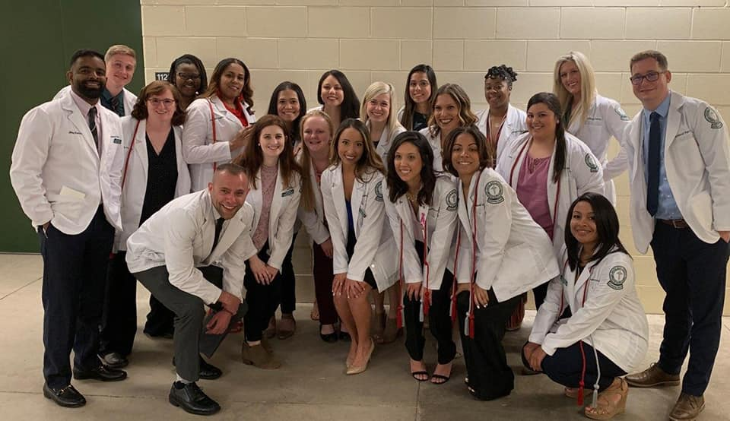
FOR MORE INFORMATION
OT PROGRAM
https://www.csu.edu/collegeofhealthsciences/OT/
DOTW SCHOLARSHIP
https://www.csu.edu/collegeofhealthsciences/OT/DOTW_grant.htm

Slide 22
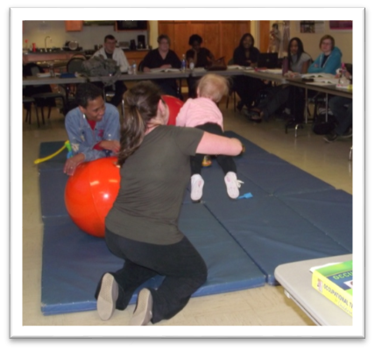
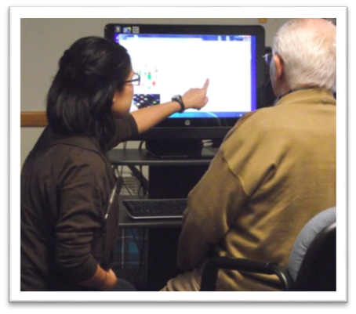
Department of Occupational Therapy
Monthly Information Session
bacot@csu.edu

