Slide 1
COLLEGE OF HEALTH SCIENCES
We empower, engage and educate health professionals and researchers who are change agents in healthcare to improve health across all life spans.
Dr. Tyra L. Dean-Ousley, Acting Dean College of Health Sciences

Slide 3
College of Health Sciences
Highlights
100% JOB PLACEMENT
EVIDENCE BASE
RESEARCH
INTER-PROFESSIONAL COLLABORATION
1:12 FACULTY STUDENT RATIO
.

Slide 4
College of Health Sciences
Guaranteed Admission Program Criteria
For Freshman Only
High School Completion
ACT score of 23 or above; or
SAT score of 1400 or above;
High School Grade Point Average: 3.25 or higher
History of participation in service activities

Slide 5
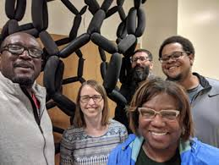
Undergraduate Program Offerings
Public Health
Health Information Administration
Nursing
Pre-PT
Pre-OT
RN to BSN

Slide 6
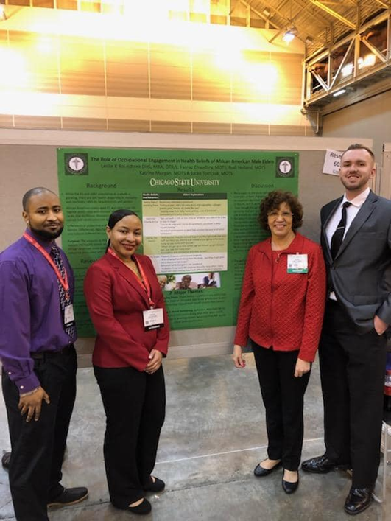
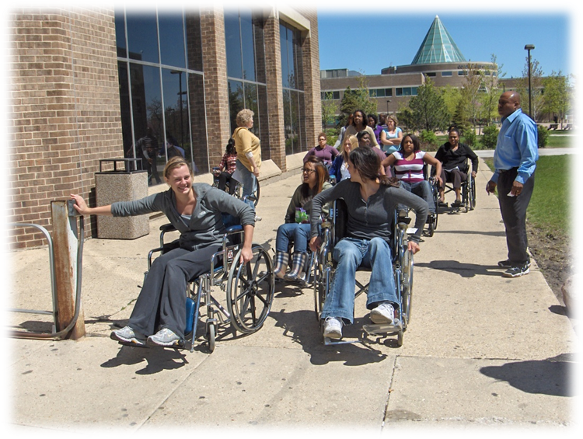
Graduate Program Offerings
Masters in Occupational Therapy
Masters in Public Health

Slide 7
HOW DO I GET THERE?

Slide 8
MATH SCIENCE CRITICAL THINKING

Slide 9
ACCREDITATION

Slide 10
CLINICAL PARTNERSHIPS

Slide 11
Department of Nursing
BSN Program

Slide 12
Admission Requirements
Meet the general admission requirements of the University and be enrolled as a pre-nursing major.
Attain a cumulative and science grade point average of 2.75 on a 4.0 scale.
Students must complete an entrance examination, a personal essay of 400 words, describing what influenced your decision to enter the nursing profession and submit three recommendation letters.
For more information contact nursing@csu.edu

Slide 13
Health Information Administration (HIA)
Professional Phase Advisory Session
December 4, 2020
Cheryl P. Jackson, MA, RHIA, CCS, PTS

Slide 14
Health Information Administration
Cheryl P. Jackson, MA, RHIA, CCS, PTS
Health Information Administration(HIA) Director
College of Health Sciences
Chicago State University
9501 S. King Drive
BHS 424
Chicago, Illinois 60628
Phone:773-995-2593
Email: cjacks67@csu.edu

Slide 15
Health Information Administration
CAHIIM defines the discipline of health information management (HIM) as the practice of acquiring, analyzing, and protecting digital and traditional medical information vital to providing quality patient care, a combination of business, science, and information technology.

Slide 16
Health Information Administration
Chicago State University Health Information Administration’s Program is governed by the core competencies created by the American Health Information Management Association (AHIMA).
Upon completion of the HIA Program, the learner can sit for the Registered Health Information Administration (RHIA) certification examination.

Slide 17
Health Information Administration
Health(CARE) Services
Compassion-Accountability-Respect-Excellence
Missional in Nature
Vision in Wholeness
Values: Facility-Specific

Slide 18
Health Information Administration
Our vision is to be recognized as a leader in health information and informatics education and to empower individuals to serve as leaders in the health information management profession.

Slide 19
Health Information Administration
Career Paths
Entry Level Credentials and Specialty Credentials
Registered Health Information Management Association (RHIA)
Coding, Privacy, Clinical Documentation, Data Analytics
https://my.ahima.org/careermap

Slide 20
Health Information Administration
Prerequisites
Declare Year Major
Anatomy and Physiology
Medical Terminology
Computer Information Systems
Critical Thinking
Introduction to Health Science Professionals
GPA 2.5: Minimum
Pre-HIA: Freshman and Sophomore Years
HIA: Junior and Senior Years

Slide 21
Health Information Administration
Application
References
Request application from COHS advisor
March 1 or until application process closes
Three References
One Academic
One Work
One Personal

Slide 22
Health Information Administration
Essay
Graphical Construction
An essay (400 words) explaining the motivation for pursuing health information administration and intended career goals;
Interview
Submit to a personal interview with the HIA Admission’s Committee
Create a graphical construction based upon a pre-established case study.
Background
Interest In Health Information
Values
Work History
Problem Solving
Leadership Roles

Slide 23
Health Information Administration
Forty (40) hours of externally supervised professional practice experience.
Meaningful Projects (Virtual or Face-to-Face)
Physical examination, immunizations and a Criminal Background Check.
Spring of Junior Year: Technical
Spring of Senior Year: Management

Slide 24
Department of Public Health
Dr. George Smith,
Public Health Faculty

Slide 25
What is Public Health?
Public health is the science of protecting and improving the health of people and their communities. This work is achieved by promoting healthy lifestyles, researching disease and injury prevention, and detecting, preventing and responding to infectious diseases.

Slide 26
Core Disciplines of Public Health
Biostatistics
Epidemiology
Environmental and Occupational Health
Health Policy and Administration
Social and Behavioral Sciences

Slide 27
10 Essential Public Health Services
The 10 Essential Public Health Services provide a framework for public health to protect and promote the health of all people in all communities.
(CDC, 2020).

Slide 28
Ten Great Public Health Achievements United States, 1900-1999
Vaccination
Motor-vehicle safety
Safer workplaces
Control of infectious diseases
Decline in deaths from coronary heart disease and stroke
Safer and healthier foods
Healthier mothers and babies
Family planning
Fluoridation of drinking water
Recognition of tobacco use as a health hazard
Source: Published in MMWR (Morbidity and Mortality Weekly Report) by the U.S. Centers for Disease Control and Prevention (CDC)

Slide 29
Department of Public Health
Mission
The mission of the Department of Public Health at Chicago State University is to provide community/public health and pre-physical therapy education to a culturally diverse, non-traditional and traditional student body. Our academic programs promote interdisciplinary educational experiences in the classroom setting and service learning experiences in the community where students apply their critical thinking skills.
Vision
The Department of Public Health at Chicago State University seeks national and international recognition as a leader in teaching, research and service. We motivate our students to become lifelong learners and to seek professional/graduate studies in the area of epidemiology and biostatistics, public health administration and policies, and physical therapy.

Slide 30
Master of Public Health Program
Mission
The program’s mission is to prepare public health practitioners and scholars who are able to identify and assess the needs of communities and populations; plan, implement and evaluate programs in order to enhance health and achieve equity in health status through organized community efforts, especially among urban minority populations.
Vision
The vision of the Master of Public Health (MPH) Program is to improve/impact the primary prevention initiatives for health in the Chicagoland area, state, region and globally through leadership in teaching, research and service.
Values
Equity
Diversity
Social Justice
Life-long learning
Personal, professional and academic integrity
Leadership
Notes:
(For more layout options, go to the “New Slide” drop-down menu)

Slide 31
Bachelor of Science in Public Health Program
Graduates of the CSU BS in Public Health Program will be able to :
Apply psychological and sociological theories in explaining human behaviors in different clinical scenarios.
Comprehend the factors that influence health and well being.
Promote health and prevent disease by positively influencing the behavior of clients.
Determine individual and Public Health needs by using valid health information and appropriate evaluative methods.
Understand the US health care system and respond ethically to health care disparities.
Comprehend published research in public health.
Notes:
(For more layout options, go to the “New Slide” drop-down menu)

Slide 32
Faculty
Department of Public Health faculty are very passionate about health equity and educating the next generation of public health practitioners and researchers.
Joseph Balogun, PT, PhD, FACSM
Distinguished Professor, PT/Research Methods/Biostatistics/Alternative Health Care
Thomas Britt, MD, MPH
Clinical Sciences and Health Policy
William Ebomoyi, PhD; Post Doctorate (NIH)
Professor, Epidemiology
George R. Smith, Jr., EdD, MPH
Assistant Professor, Social and Behavioral Sciences
Yashika Watkins, PhD, MPH
Associate Professor, Health Policy and Administration
Notes:
(For more layout options, go to the “New Slide” drop-down menu)

Slide 33
Job Growth
Employment in healthcare occupations is projected to grow 15 percent from 2019 to 2029, much faster than the average for all occupations, adding about 2.4 million new jobs. Healthcare occupations are projected to add more jobs than any of the other occupational groups. This projected growth is mainly due to an aging population, leading to greater demand for healthcare services.
U.S. Department of Labor, September 1, 2020

Slide 34
Public Health Careers
Biostatistician
Epidemiologist
Public Health Nurse
Social Worker
Health Educator
Health Department Administrator
Environmental Scientist
Project Manager
Health Services Manager
Health Policy Analyst
Professor
Sanitarian
Computer/Information System Manager
Infection Preventionist
Clinical Research Coordinator
Outreach Coordinator

Slide 35
Department of Nursing RN to BSN Program
Dr. Rupa Potti
Nursing Faculty

Slide 36
Why BSN Degree??
Expanding professional roles
Hiring preferences of hospitals for BSNs. (Specially Magnet Status)
Leadership positions require higher degrees
Professional advancement (Advanced Practice Nurses, Nurse Practitioners, Certified Nurse Anesthesiologist, academia etc).
Pay incentives

Slide 37
Additional Courses at CSU RN-BSN
Professional Development
Health Assessment
Nursing Informatics
Nursing Pathophysiology
Health Promotion
Community Based Care of Family
Research Methods
Nursing Leadership & Mgmt
Advanced Therapeutics

Slide 38
CSU RN-BSN Program
Only 3 semesters
12 months completion
One night a week class (Remote due to Covid)
Approved by the Illinois Department of Financial and Professional Regulations {IDRPR}
Accredited by the Accreditation Commission for nursing Inc. {ACEN}

Slide 39
Admission Requirements
1. A nonrefundable university application fee. (Application fee is waived for Spring 2021)
2. Minimum one year clinical experience.
3. Official transcripts from degree-granting institution, reflecting a minimum grade point average of 2.75 or higher on a 4.0 scale.
4. RN license verification and work experience acknowledgement form that verifies current unrestricted RN license to practice in the State of Illinois*
5. Meet the university prerequisite requirements for Bachelor Degree criteria as traditional nursing students
For more information contact nursing@csu.edu

Slide 40
Occupational Therapy
Dr. Regina Smith, Faculty

Slide 41
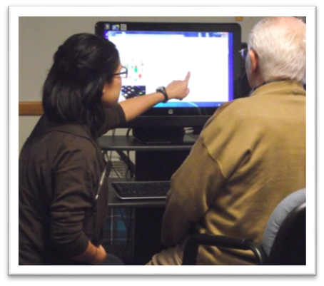
OCCUPATIONAL THERAPY
Health care profession concerned
with health and well-being by
promoting people’s engagement in meaningful activities or occupations they need and want to do.
Occupational therapy (OT) practitioners work with people across the lifespan in a variety of settings such as hospitals, clinics, rehabilitation centers, long-term care facilities, camps, homes, and community agencies. schools, mental health.

Slide 42
OCCUPATIONAL THERAPY CAREER OUTLOOK
Demand expected to increase much faster than average through 2029. (Bureau of Labor Statistics, 2020)
Expanding roles in areas such as mental health, home modification and accessibility design, driver rehabilitation, ergonomic, low vision services, assistive technology, competitive integrative employment services, community health services.

Slide 43
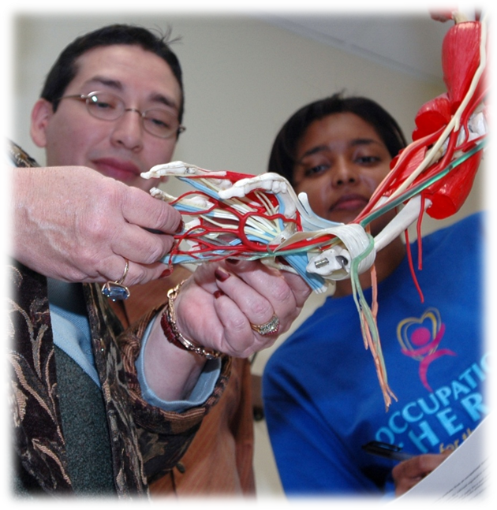
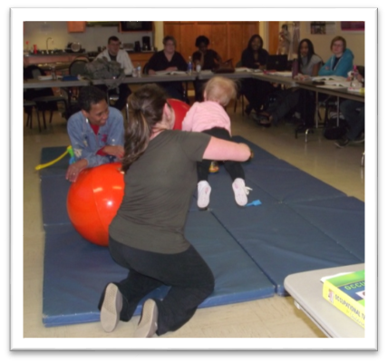
CSU OCCUPATIONAL THERAPY PROGRAM
Established in 1982
2nd oldest OT program in Illinois
Entry-level Masters Degree
Two pathways to enter the professional OT program
Combined Program (BS/MOT)
Masters of Occupational Therapy

Slide 44
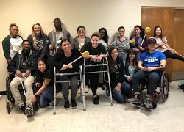
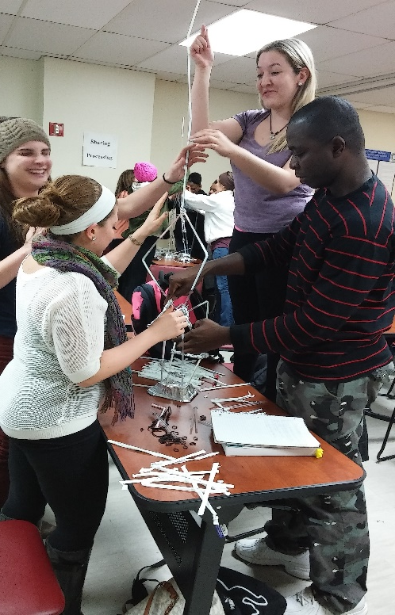
Why CSU’s OT PROGRAM?
Diverse student population
Integrated curriculum design
Wellness to Disability continuum
Emphasis on preparing students for community and emerging practice areas
NBCOT passage rate

Slide 45
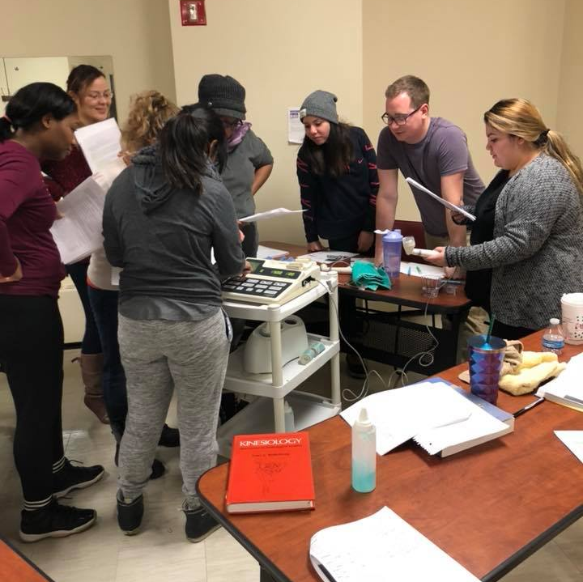
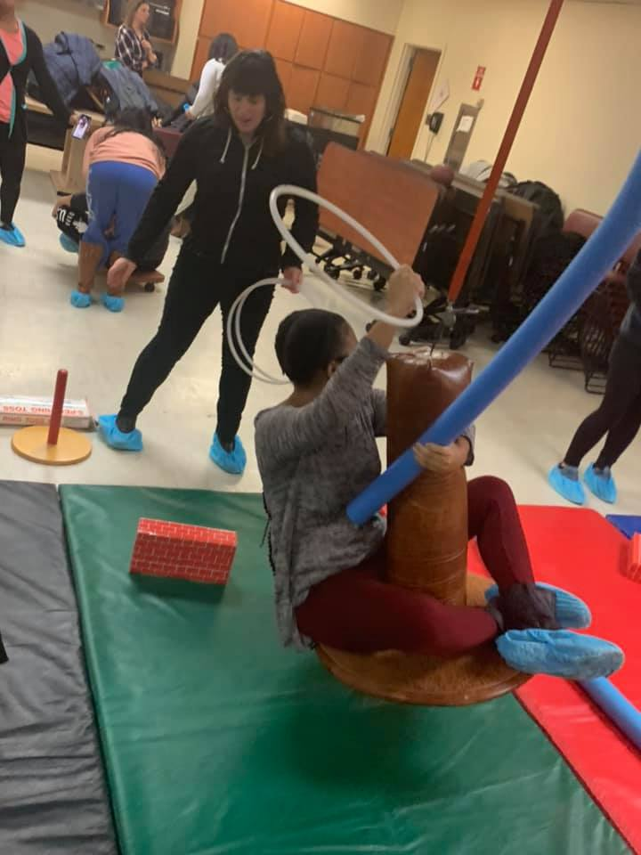
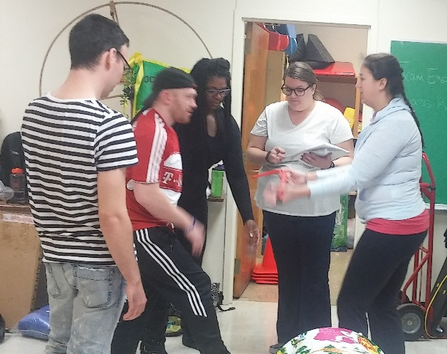
Why CSU’s OT PROGRAM?
Class size
Faculty teach in areas of expertise
Academic support & advising
Peer mentoring

Slide 46
OCCUPATIONAL THERAPY SCHOLARSHIP OPPORTUNITY
Diversifying the OT Workforce (DOTW) Scholarship for Disadvantaged Students Grant
Federal grant
Assists MOT students who have a low income complete the OT program
Goals
Increase diversity in OT profession
Train a diverse workforce to work in medically underserved communities

Slide 47
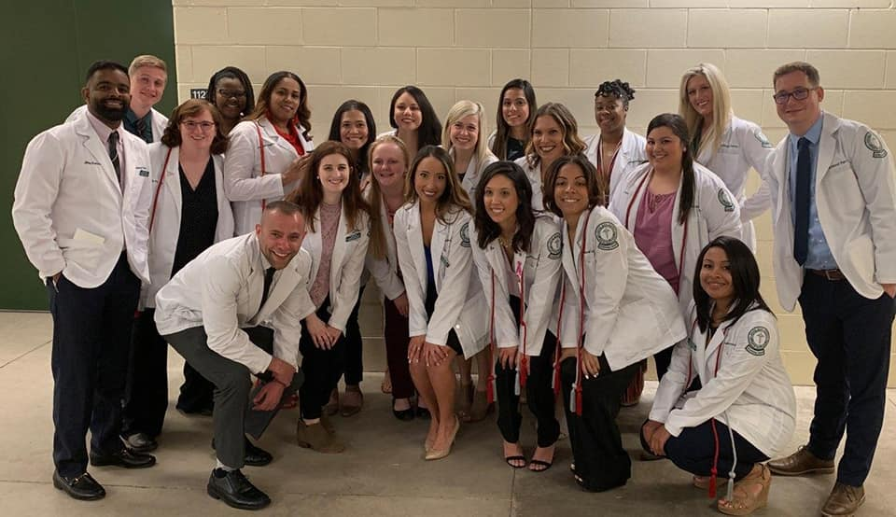
FOR MORE INFORMATION
OT PROGRAM
https://www.csu.edu/collegeofhealthsciences/OT/
DOTW SCHOLARSHIP
https://www.csu.edu/collegeofhealthsciences/OT/DOTW_grant.htm

Slide 48
Contact information
Academic Advisor: Ms. Constance Upshaw cjacks35@csu.edu
Public Health: Dr. George Smith, gsmith33@csu.edu
Health Info Adm: Professor Cheryl Jackson cjacks67@csu.edu
RN to BSN: Dr. Rupa Potti rpotti@csu.edu
Nursing: Dr. Tyra L. Dean-Ousley tdean21@csu.edu
OT: Dr. Regina Smith, rsmith31@csu.edu
https://www.csu.edu/collegeofhealthsciences/

Slide 49
QUESTIONS

