Slide 1

Nursing
BSN and RN to BSN Informational Session

Slide 2
Pre-Nursing/How do I get started?
Meet with the College of Health Science academic advisor
  Constance Jackson-Upshaw cjacks35@csu.edu
  Sara Oceguera soceguer@csu.edu
  Meet University General Education requirements
Complete and pass CSU specific courses
  Service Learning (HSC 3321)
  Introduction to Health Professions (HSC 2150)
Notes:
(For more layout options, go to the “New Slide” drop-down menu)

Slide 3
Admission Requirements
  Minimum GPA of 2.75
  Nursing application submission (found on CSU nursing website)
  Personal essay (400 word minimum)
  Three letter of recommendations (recommendation forms on CSU nursing website)
  TEAS test
  http://www.csu.edu/collegeofhealthsciences/nursing/index.htm
Notes:
(For more layout options, go to the “New Slide” drop-down menu)

Slide 4
Application Deadline
  Fall admission:
  ALL requirements are due by May 15
Notes:
(For more layout options, go to the “New Slide” drop-down menu)

Slide 5
Annual Clinical Requirements
American Heart Association Healthcare Provider Cardio-Pulmonary Resuscitation (CPR) – 2 years
• Tuberculosis (TB) testing - annual
• Standard Precautions Review – annual
• HIPPA (Health Insurance Portability and Accountability Act) Training -annual Code of Conduct Acknowledgement Form – annual
Notes:
(For more layout options, go to the “New Slide” drop-down menu)

Slide 6
Required Vaccinations
Measles, Mumps, Rubella Varicella
Hepatitis B
Annual Influenza
DTAP
2-step TB, annual one-step TB, or Quantiferon® - TB Gold results
COVID-19 Vaccination (required by majority of the clinical sites)

Slide 7
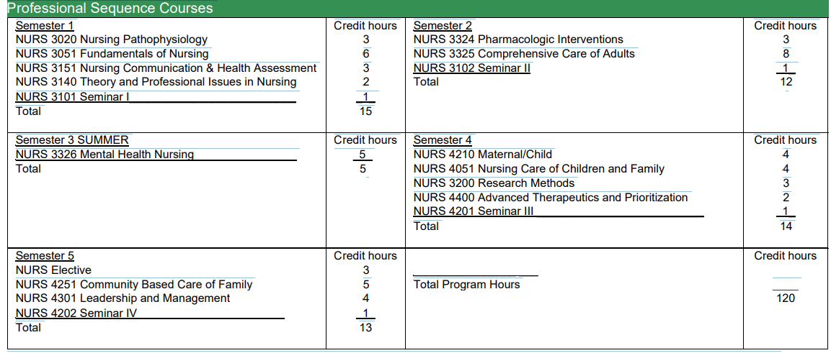

Slide 8
Nursing Student Experience
Eligible to take CNA exam after completing Fundamentals Course
Clinical settings
  Hospitals
  CPS
  Clinics
Simulation
  Virtual
  High to Mid fidelity mannikins
  Standardized patients

Slide 9
RN to BSN Program
Complete in one calendar year
3 semesters
5 week courses
hybrid/online courses
Low Student: Faculty Ratios
*Contact the nursing department for application deadlines nursing@csu.edu

Slide 10
RN to BSN Admission Requirements
Nonrefundable university application fee
Must currently work as a Registered Nurse
Official transcripts, minimum of 2.75 GPA
Associate degree in nursing or nursing diploma from an accredited nursing program

Slide 11
RN to BSN Admission Requirements
RN license verification
Work experience acknowledgement form
Meet the university prerequisite requirements for Bachelor Degree criteria
*Required forms can be obtained by reaching out to the nursing department, nursing@csu.edu

Slide 12
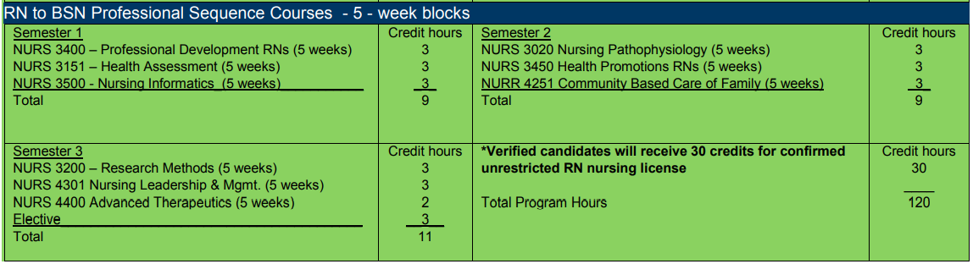

Slide 13

Contact Information
Location: Business & Health Sciences Building (BHS)
Room: 200A
Office Hours: 8:00 am -4:00pm
Monday through Friday
Phone: (773) 995-3992
Fax: (773) 821-2438
Email: nursing@csu.edu

