Slide 1

Getting Started with Open Education Resources
Presentation at Chicago State University 3-9-16
Dr. Page Wolf, College of Lake County

Slide 2
College of Lake County’s path to using OER
About CLC
What exactly is (are?) OER?
Our process
Our challenges
Our next steps
Notes:
Talk about CLC and its demographics

Slide 3
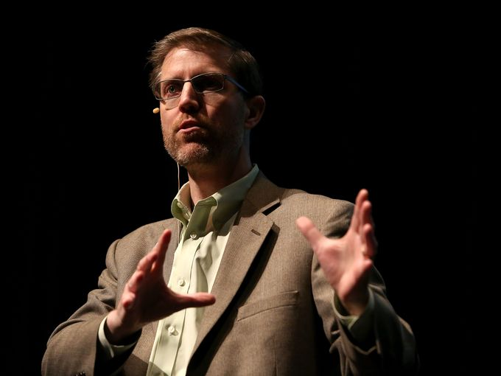
It started with this guy…
Cable Green, Director of Global Learning
Creative Commons
Keynote, January 2014
Notes:
What is Creative Commons?
Creative Commons is a nonprofit organization that enables the sharing and use of creativity and knowledge through free legal tools.
Our free, easy-to-use copyright licenses provide a simple, standardized way to give the public permission to share and use your creative work — on conditions of your choice. CC licenses let you easily change your copyright terms from the default of “all rights reserved” to “some rights reserved.”
Creative Commons licenses are not an alternative to copyright. They work alongside copyrightand enable you to modify your copyright terms to best suit your needs.

Slide 4


The Power of Open:
The Learning, Business
& Policy Case for OER
January 2014 Orientation Week Keynote
Dr. Cable Green
Director of Global Learning
cable@creativecommons.org
@cgreen

Slide 5
What are Open Education Resources?
OER are teaching, learning, and research materials in any medium that reside in the public domain or have been released under an open license that permits their free use and re-purposing by others.
Cc by Cable Green

Slide 6
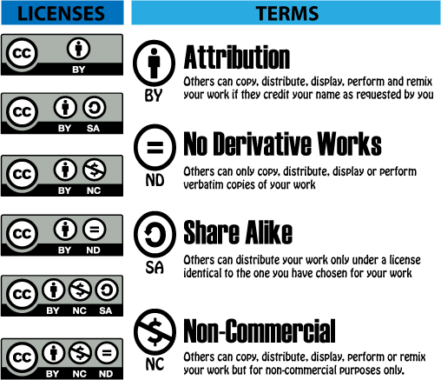
Creative Commons
Image source: http://education-copyright.org/creative-commons/

Slide 7

Makes it easy to share:5Rs
Credit: Nicole Allen, SPARC / See www.opencontent.org for full definition.
Notes:
Retain=BUILD. Similar in scope to writing a new text with many collaborators.
Reuse=This is MY content
Revise=ADAPT. Similar in scope to moving from tradition to fully online delivery. This is a starting point for improvement
Remix=This is the best collection of material for each concept or outcome
Redistribute=This exists in a community of collaborators

Slide 8
Why use OER?
At the course level:
OER provides faculty with more choices for their courses
OER allows for permission free editing and adaptation
OER prevents faculty from being locked into a particular platform or system
Eliminate textbook cost as a barrier to student success!
CC licensed open textbooks are one solution to enable creativity, customizability, keep materials up to date, and make learning materials more affordable!
CC BY: OpenStax College
Notes:
OER enhance academic freedom in several ways.
Because you are free to choose and use any OER materials you like, without asking for permission.
------
Let’s be honest, YOU are the best one to make decisions on what is best for the student in your course. It is just that simple.
Being from Rice we understand the value of academic freedom and believe that OER should never be mandated.

Slide 9
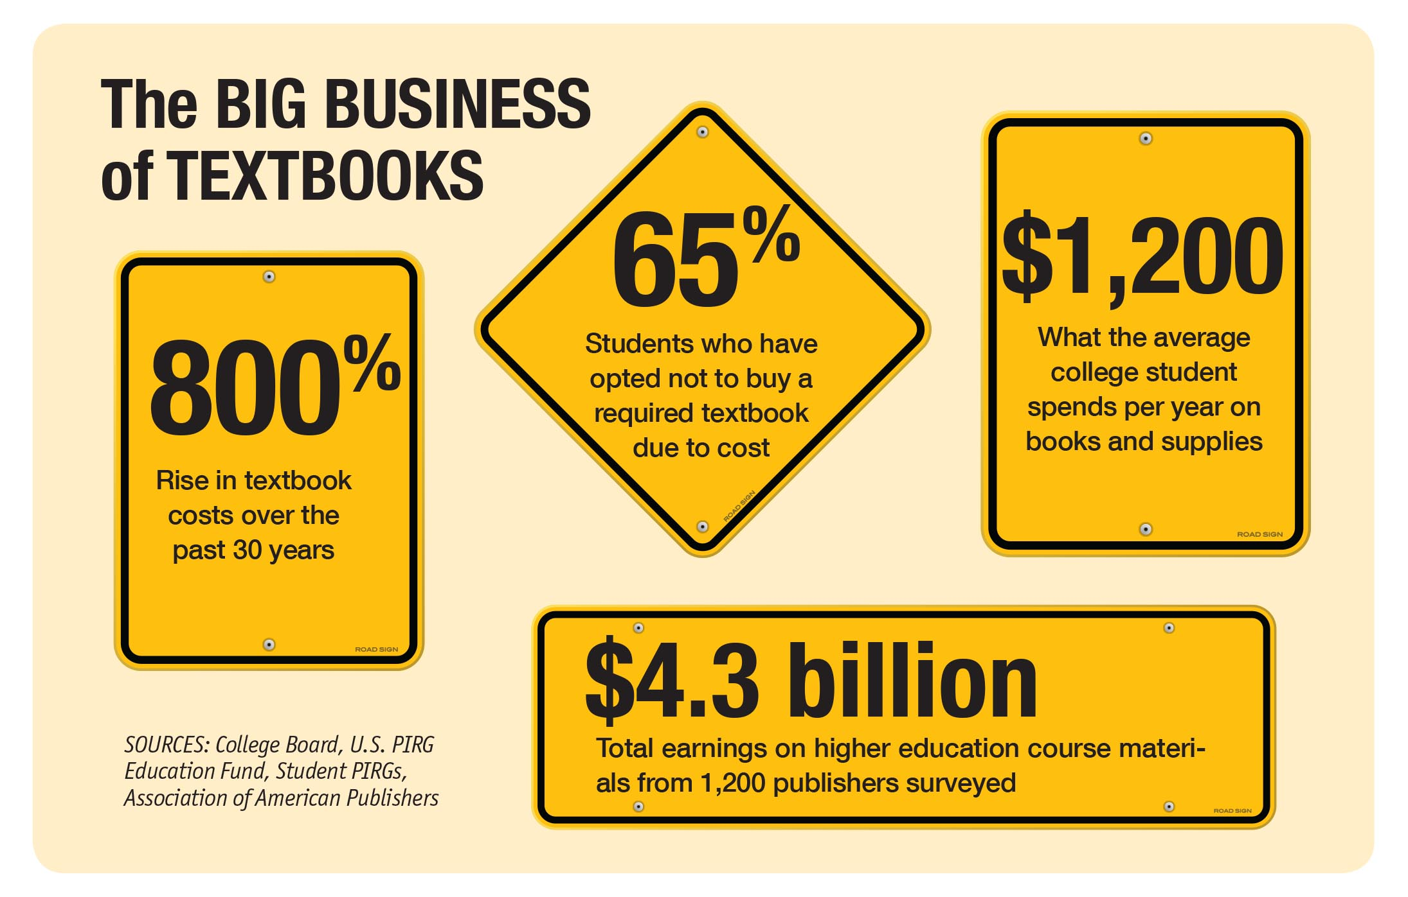
(Article): University Business: College textbook forecast: Radical change ahead
http://www.universitybusiness.com/article/college-textbook-forecast-radical-change-ahead
Notes:
65 percent of students said they didn’t buy a required textbook because it was too expensive
… even as 94 percent of this group expressed concern that it would hurt their grade.
Nearly half of all students surveyed said textbook costs affected how many or which classes they would take in a given semester.

Slide 10
Source http://www.gao.gov/products/GAO-13-368
Notes:
Textbook prices have nearly doubled, increasing 82% or about three times the rate of inflation between 2002 and 2012. Government Accountability Office (2013). College Textbooks: Students Have Greater Access to Textbook Information.
(GAO 13-368). Retrieved from http://www.gao.gov/products/GAO-13-368

Slide 11
Expand availability and discoverability of OER
Expand adoption, adaptation and building of OER
Nicole Allen, SPARC: CC BY

Slide 12
$30 MILLION+ SAVED!
CC BY: OpenStax College
Notes:
One notable project is OpenStax College based at Rice University, which is publishing 20 open textbooks for the highest enrollment courses in U.S. schools. Their existing seven titles are used by more than 900 courses worldwide and have saved students more than $13 million to date. Like most open textbooks, the OpenStax books are available online for free, immediate download in PDF and ePub format. They can also be printed locally, or purchased in print for $30-50 dollars depending on the title.
Rice University (2014). Rice's OpenStax College will add 10 new titles by 2017 [press release]. Retrieved from http://openstaxcollege.org/news/rice-s-openstax-college-will-add-10-new-titles-by-2017.

Slide 13
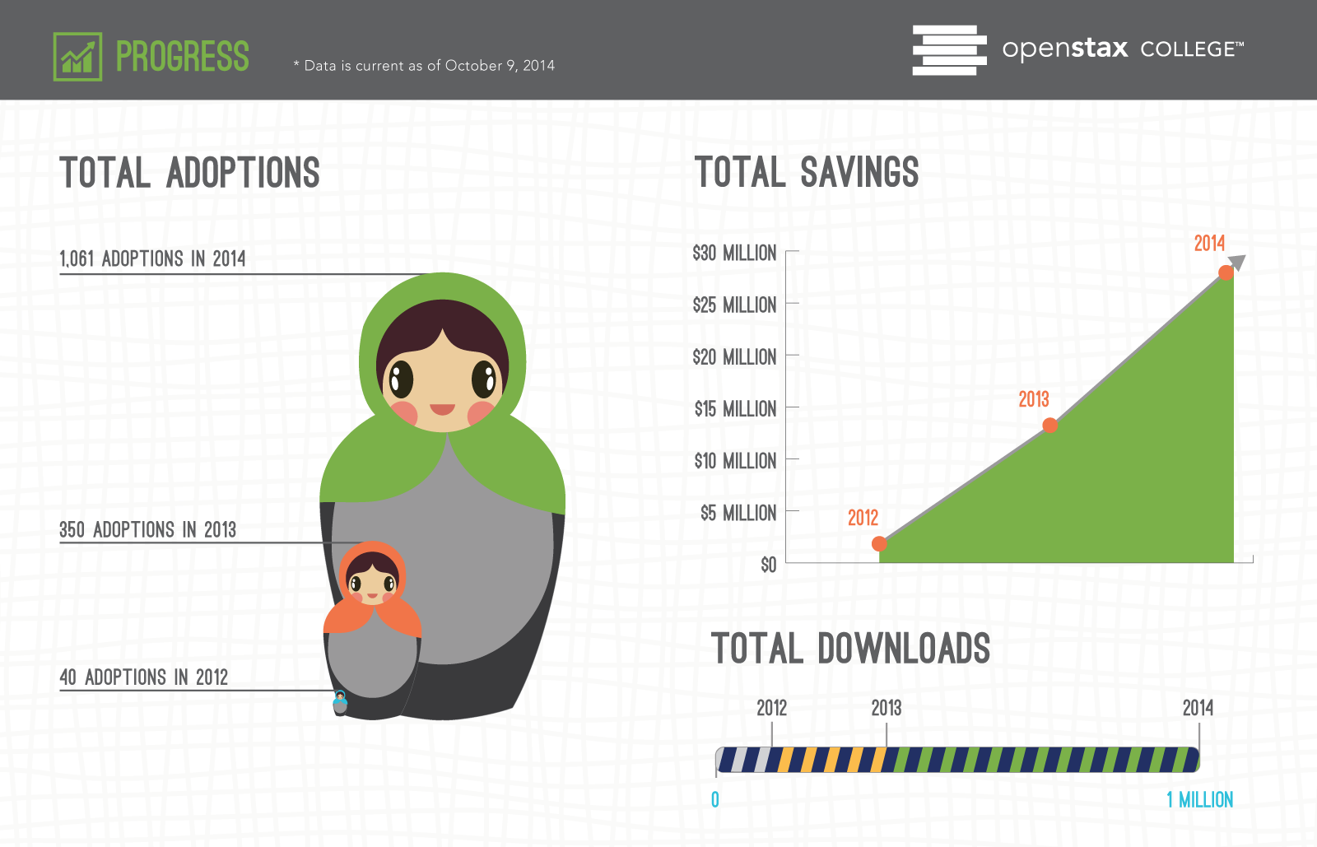
CC BY: OpenStax College
Notes:
We did it – OpenStax College has been adopted by instructors in more than 1,000 courses worldwide in less than three years and we've saved students $30 million since we published our first title. Read the press release here: http://openstaxcollege.org/news/our-textbooks-have-saved-students-30-million

Slide 14
There is a direct relationship between textbook costs and student success
60%+ do not purchase textbooks at some point due to cost
⓪①⓪①⓪①
①⓪①⓪
50% take fewer courses due to textbook cost
⓪①⓪①
31% choose not to register for a course due to textbook cost
23% regularly go without textbooks due to cost
①⓪①
⓪①
14% have dropped a course due to textbook cost
①
10% have withdrawn from a course due to textbook cost
Source: 2012 student survey by Florida Virtual Campus
www.projectkaleidoscope.org
Notes:
2 in 3
Students say they decided against buying a textbook because the cost is too high
1 in 2
Students say they have at some point taken fewer courses due to the cost of textbooks
Source http://www.uspirg.org/reports/usp/fixing-broken-textbook-market

Slide 15
The Vision
⓪①⓪①⓪①⓪①⓪①
100% of students have
100% free, digital access to all materials on day 1
Drive student success by designing, adopting, measuring and improving OER-based courses
www.projectkaleidoscope.org
Notes:
A 2010 study by the Student PIRGs found that using open textbooks in place of traditional textbooks reduces costs 80%, or an average of $107 per course. The savings are often higher.
The Student PIRGs (2010). A Cover to Cover Solution: How Open Textbooks are the Path to Textbook Affordability. Retrieved from http://www.studentpirgs.org/reports/cover-cover-solution.

Slide 16
New Student PIRG report
http://www.studentpirgs.org/news/sp/student-group-releases-new-report-textbook-prices
Almost one-third (30%) of students replied that they had used financial aid to pay for their textbooks.
For those that used financial aid, the amount of financial aid dollars they put toward purchasing textbooks was more than $300 on average per semester.
Textbook prices disproportionately impact community college students: 50% of students report using financial aid for books at community colleges, compared to 28% at 4 year public schools. And, on average, community college students use more financial aid than their peers at 4 year schools.
That means that nearly 5.2 million U.S. undergraduate students spend a total of $1.5 billion dollars of financial aid on textbooks every semester, or $3 billion per year.

Slide 17
How are students supposed to learn with materials they can’t afford and are not buying?
Notes:
It has become clear that the cost of textbooks has reached a point where there are two classes of students: those who can afford reliable access to their course materials, and those who cannot. - Nicole Allen, SPARC

Slide 18
So…what about CLC?
Favorable reaction to Cable Green presentation
How to get faculty started? What is the best process?
  Faculty innovators
  Email of faculty interest (about 20)
  IEPR study
  Lumen Learning-Consultant

Slide 19
Faculty Approaches
BUILD
Similar to writing a new text
Develop or aggregate new materials
ADAPT
Similar to moving from traditional to online delivery
Identify high quality course or resource
ADOPT
Similar to using a new text or major new edition
Review open course or text
Create media
Share or publish
Create significant revision
Remix/aggregate
Refine for teaching approach
Align with syllabus

Slide 20
Concerns
Confusion--Open Textbooks vs. eText vs. lecture notes/websites vs. Library Database articles (all of these are low/no cost alternatives)
Time--looking for sources, creating from scratch
Logistics--will students read online or prefer print copy, will courses transfer
Textbook publishers--dominant names in field, bells and whistles, common textbook policy

Slide 21
Innovators—Psychology 121
(Lally/Valentine-French)
Received Foundation Grant to develop course
Used existing text with major revision/adaptation
Summer 2014--review and modify each chapter
Fall 2014—developing interactive activities, assessments, slides
Piloted 10 classes in Spring 2015; 26 classes in Fall 2015 (both full-time and adjunct faculty)
Issue: working with bookstore to determine how to publish
Notes:
Textbook costs $7

Slide 22
Innovators—Math 222 (Reed/Kurup)
Concerned with growing financial pressure on students
Wanted to try OER with specific criteria
  something that matched course topics well, with good quality
  Wanted to adopt existing work as would with commercial publisher text
Found text already in existence from OpenStax; adopted as is
PDF/web version free; print version $33
Less flashy than text but way less expensive; will survey students after this semester

Slide 23
Innovators—English 121 (Latza)
Using free OER sources, handouts and vetted Internet sources
Kept 20 copies of past text edition for students who wanted hard copy; only 3 students used.
Total savings
  $8786.25 (45 students x $195.25 textbook cost)

Slide 24
CLC Top 10 High Enrollment Courses
COURSE | Total Seats 2010-14 | Highest book cost | Textbook spending
English Comp I | 16,552 | $194 | $802,772
Intro to Psych | 14,801 | $101 | $373,725
Fundamentals of Speech | 11,281 | $151 | $425,858
English Comp II | 9,614 | $219 | $526,367
Basic Algebra | 9,291 | $127 | $294,989
Intro to Sociology | 7,821 | $83 | $162,286
Intermediate Algebra | 7,214 | $127 | $229,045
Intro to Business | 5,324 | $88 | $117,128
Principles of Bio | 4,244 | $135 | $143,235
Intro to Ethics | 4,159 | $174 | $180,917
Notes:
Textbook spending=averaged seats x cost

Slide 25
Lumen Learning (www.lumenlearning.com)
Mission: Scale effective use of OER and analytics
  Improve access and quality
  Impact disadvantaged learners
Partially owned by a charitable foundation
Guide institutional leaders/Guide and support faculty members
Invest in continuous improvement based on learning results

Slide 26
Professional Development Center Summer 2014 OER offerings
1 day hands on workshop—9 faculty participants
  Introduction to Open Course Delivery
  Preparing an Open Course
  Preparing for Success
Orientation week webinar—25 faculty participants
Continued webinar offerings CCCOER—Community College Consortium of Open Education Resources
Notes:
Spring 2016 webinars--2/10--OER and faculty development; 3/9--OER--faculty adoption/student voice; 4/13--faculty perspectives on OER

Slide 27
Where Are We At Now?
Contact list of interested faculty to determine:
  If still interested in OER
  If yes, what is timeline for developing
  If delayed, what are barriers or concern
Departmental initiatives
  Business and Social Science Division $1,000,000 challenge to reduce textbook costs (OER or publisher deals)
In progress—Developmental English, History, Earth Science, Counseling, Statistics, English Language Instruction, Psychology (Foundation Grant funding)

Slide 28
Where Are We At Now?
Contact list of interested faculty to determine:
  If still interested in OER
  If yes, what is timeline for developing
  If delayed, what are barriers or concern
Lumen Learning follow-up webinar (to answer questions from summer workshop participants)
Departmental initiatives
  Business and Social Science Division $1,000,000 challenge to reduce textbook costs (OER or publisher deals)
In progress—Developmental English, History, Earth Science, Counseling, Statistics, English Language Instruction, Psychology

Slide 29
What are other schools/states doing?
University of Minnesota online catalog of open textbooks (saved $100,000)
Tidewater Community College
  Z-degree: Nation’s first zero-textbook-cost associate degree program (only uses OER)
Washington State’s Open Course Library (81 largest enrollment courses, $5.5 million saved as of last year)

Slide 30
Closer to home…
State of Illinois—Affordable College Textbook Act (Bill S.1704) from November 14, 2013 (Durbin D-IL and Franken D-MN)
  Grant program to support pilot programs at colleges
  Ensures freely available and easily accessible OER
  Colleges must report on effectiveness
  Improves existing requirements for publishers
  Report price trends of college textbooks to congress
SIU Edwardsville—piloting 11 courses this fall

Slide 31
Feedback from CLC faculty
Developing OER takes time!
  Search time, reading through materials, development of text, updating
  Release time is vital for those developing materials
  Support materials
Process of publishing to provide print option to students (Bookstore? Print services? Other?)

Slide 32
Next Steps
How many OER texts would we like to see? Timeline?
Areas of priority
  Number of students impacted?
  Number of sections?
  Representation from each division?
  How many faculty are involved in creation
  Current textbook costs?
  Areas where no OER currently exist vs readily existing materials
Incentives for faculty to use/develop OER
  Different if use existing course vs. develop from scratch or even modify
How do we indicate classes where OER are used to students?
OER full courses

Slide 33

Keys to success at CLC
Administrative support
Faculty meeting
Grants
Involvement of Deans ($1,000,000 Challenge)
Outreach (faculty and students)

Slide 34


Open Education Consortium/Community College Consortium for OER
http://oeconsortium.org
http://oerconsortium.org
Notes:
Campus Promotion Kit, Webinars, Resources, Repositories, Listserv, Membership, OER Week

Slide 35
Listservs
CCCOER Recent topics:
  Astronomy open text
  Slides for OER Advisory Committee webinar meeting
  Open Ed Week 2016 Call for Participation
  Open Licensing and Copyright FAQ (http://www.openwa.org/faq )
  NOVA Shares Open Courses and OER
  Major Study Finds OER Students Do Just As Well or Better (https://campustechnology.com/articles/2015/11/10/major-study-finds-oer-students-do-just-as-well-or-better.aspx)
Educause OPENNESS Recent topics:
  Open Apereo 2016 (conference in New York)
  State of the Commons Report (https://stateof.creativecommons.org/2015/)
  U.S. Dept of Education Call for Open Licensing Policy Comments

Slide 36
CLASSES
Open Washington MOOC
  http://www.openwa.org/module-1/
P2PU (Peer to Peer University) MOOC
  https://p2pu.org/en/courses/140/intro-to-openness-in-education/

Slide 37
Resources
http://thepowerofopen.org/ (free PDF download)
http://www.americanprogress.org/issues/labor/news/2012/02/07/11167/dramatically-bringing-down-the-cost-of-education-with-oer/
http://www.educause.edu/library/resources/chapter-6-why-openness-education
http://creativecommons.org/education
http://mitpress.mit.edu/books/opening-education (click on "open access edition")
https://p2pu.org/en/courses/140/intro-to-openness-in-education/
http://wikieducator.org/Open_content_licensing_for_educators/Home

