Slide 1

A COMMUNITY CARE MODEL
CSU COUNSELING CENTER

Slide 2
COUNSELING CENTER STAFFING
Director of Counseling - Dr. Christine M. Brown
Assistant Director of Abilities - Mrs. Nicole Matthews
Licensed Clinical Counselor - Ms. Lakeisha Robinson
Counseling Interns

Slide 3

Chicago State University’s Counseling Center provides services that engage, embrace, enlighten, and empower, student’s personal, academic, and professional goals. CSU provides safety, mutual aid, guidance, peer support and wellness services.
One of the ways to achieve this?

Slide 4
ACTING AS IF………
TRAUMA HAS OCCURRED
NO, NOT EVERYONE IS IMPACTED BY TRAUMA EVENT

Slide 5
Trauma can be defined as any experience in which a person's internal resources are not adequate to cope with external stressors (Hoch, et. al., 2015)
Some traumatic experiences occur once in a lifetime, and others are ongoing
Students of Color (SOC) are at increased risk for multiple traumas that may result in chronic health conditions
Trauma can happen to both individuals and communities
Global experiences of trauma (e.g. Asian (COVID-19), Black (community violence/slavery), Hispanic (immigration), Muslim (Sept. 11th), LGBTQ, Native Americans, Youth in Care
Trauma is experienced differently based on a range of cultural contexts, as well as social and psychological variables, unique to individuals and communities (Elliot & Urquiza, 2006).

Slide 6
PTSD VS. DEVELOPMENTAL TRAUMA
The DSM-5-TR was released in March 2022 and failed to acknowledge “developmental trauma,” which describes individuals whose history of trauma causes persistent and pervasive emotional and physiological dysregulation. (Bremness & Polzin, 2014).
When an individual is dysregulated, he/she/they are unable access the rational part of their brain that allows processing/thought.
Those of us with direct contact with students may experience avoidance, anger, fear, hypervigilance, disconnect, bullying, exhaustion, difficulty establishing boundaries, giving up, over-engagement, sleeplessness, anxiety, irritability, inadequacy, and/or helplessness. Students are responding the way that their bodies are informing them to. Let me tell you why.

Slide 7
THE BRAIN
CORTEX - REASON
LIMBIC - RELATE
DIENCEPHALON - REGULATE
BRAINSTEM
The brain receives a message which activates the stress-response system which immediately shuts down the cortex. So there is no chance for a reason/rational response, which is what we expect.
Experiences are processed in the lower-level of our brains (reactive) before reaching our rational-thinking area.
A person receives the message, “I am inadequate, I am a bad person” instead of I have experienced trauma. Depending on the person in which is encountered, their messages are validated based on how we respond.

Slide 8
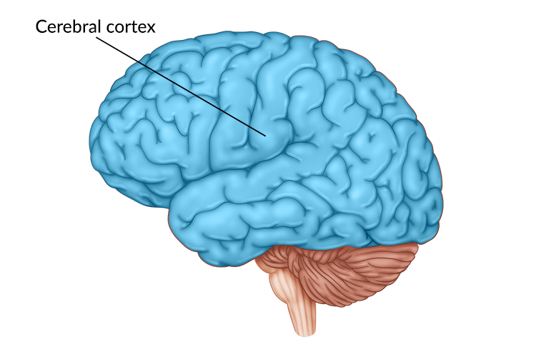
If someone is stressed, angry, frustrated, or otherwise dysregulated, the incoming input will be short-circuited, leading to inefficient and destroyed input to the cortex.
Without some degree of regulation, it is difficult to connect with another person, and without connection, there is minimal reasoning.
Regulate, Relate, then Reason.

Slide 9
TRAUMA CAN LOOK LIKE…..
Isolation
Invisibility
Shame
Unsafe
Resiliency – Get Over it – Personal Flaw
Trauma Impacts Learning & Development (memory, cognition, physical body, emotionality, relationships)

Slide 10
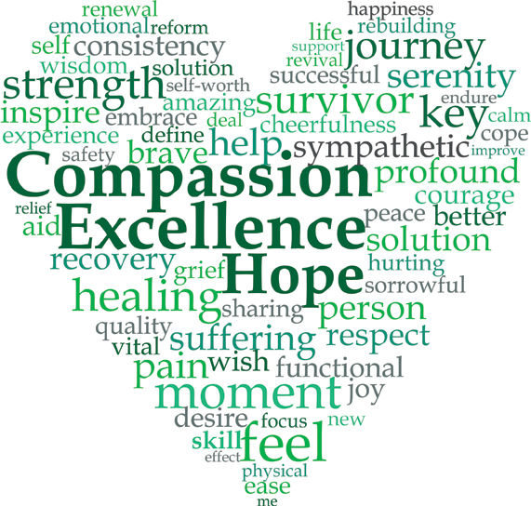
TRAUMA INFORMED CARE
University staff and faculty are responsible for recognizing that students’ actions are a direct result of their life experiences.
When students act out or disengage, do not ask what is wrong, but rather, “what happened to you?” (Huang et al., 2014)
Compassion is our responsibility and response.

Slide 11
TRAUMA RECOVERY
Requires Human Connection
Persons must be covered with community of caring individuals

Slide 12
Counseling Support
Administration, Faculty, and Staff - Front Line
Refer to the Counseling Center
We assess and integrate Mindfulness, Yoga, Meditation, and Nature with counseling techniques (CBT, etc.) to teach self-regulation
We encourage exercise, nutrition, dancing, music, art, rhythms/repetition, sports and the outdoors
Trauma happens in the body, we support movement, breathing, connecting to the five senses and bring awareness to the body.
Reprocessing trauma is traumatic
Groups in Residence Hall
WRC will relaunch in November (parenting class/women’s empowerment series
Mental health awareness events throughout the academic year

Slide 13
Counseling Center
Services
Abilities Office
Process all request for accommodations for our students with disabilities and provide those accommodations (testing, note-taking,..)
Counseling
Assessment, treatment planning, Individual/group counseling services
Psychoeducation, Case management, and Consultation
Women's Resource Center
Parenting Classes, Women Empowerment Series, Breastfeeding/Lactation site
Additional Supports
Cougar Closet - Dean Cameron
Food Pantry - Dean Cameron
Homeless Services - Dr. Brown

Slide 14

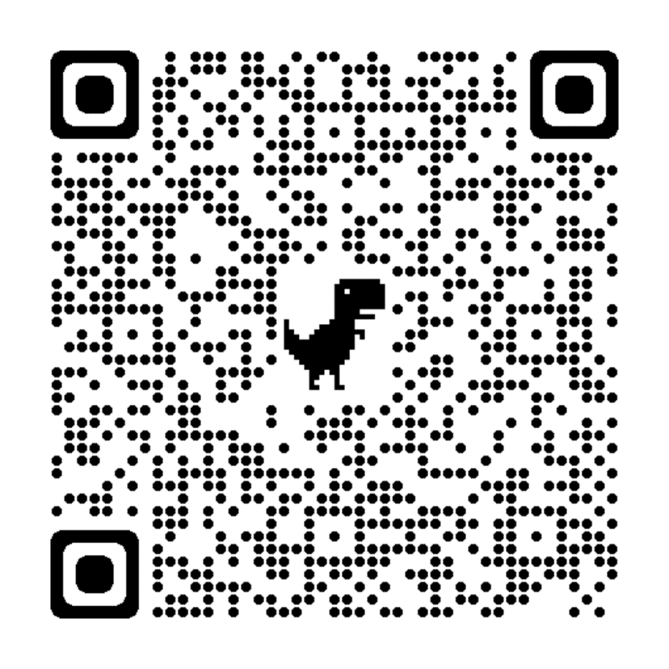
ACCESSING OUR SERVICES
COUNSELING CENTER
CORDELL REED STUDENT UNION SUITE 190
WAYS TO CONNECT
Email - counselingcenter@csu.edu Phone - 773.995.2383 Class presentation
773.995.2383
QRCode
Visit counseling center - Monday thru Friday - 9:00 am - 5:00 pm
Walk in hours - Tuesdays, 1:30 - 3:30 pm (Students will seen by a counselor on the day of visit)

